Slide 1

CAT-III
Engineering Graphics and Introduction to Digital Fabrication (BME01T1004)
SOLIDWORKS
Prepared by:
ABHINAV KUMAR CHOUDHARY (21SCSE1011615)
Semester: II Section:24
Session 2021-2022

Slide 2
School of Computing Science & Engineering
Course Code : BME01T1004 Course Name: Engineering Graphics
SOLIDWORKS
Course Code : XXXXXX Course Name: Data structures using C
What is solidworks ?
SolidWorks is a solid modeling computer-aided design (CAD) and computer-aided engineering (CAE) application published by Dassault Systèmes. SolidWorks is a solid modeler, and utilizes a parametric feature-based approach which was initially developed by PTC (Creo/Pro-Engineer) to create models and assemblies. The software is written on Parasolid-kernel.
Parameters refer to constraints whose values determine the shape or geometry of the model or assembly
Design intent is how the creator of the part wants it to respond to changes and updates.
Features refer to the building blocks of the part. They are the shapes and operations that construct the part.
Group No: Program Name: Engineering Graphics Sem: II

Slide 3
School of Computing Science & Engineering
Course Code : BME01T1004 Course Name: Engineering Graphics
WHAT CAN SOLID WORKK DO?
Create fast and accurate designs, including 3D models and 2D drawings of complex parts and assemblies.
Design for cost and manufacturing with cost estimation tools and manufacturability checks.
Interact with team members and control revisions with standardized data management tools.

Slide 4
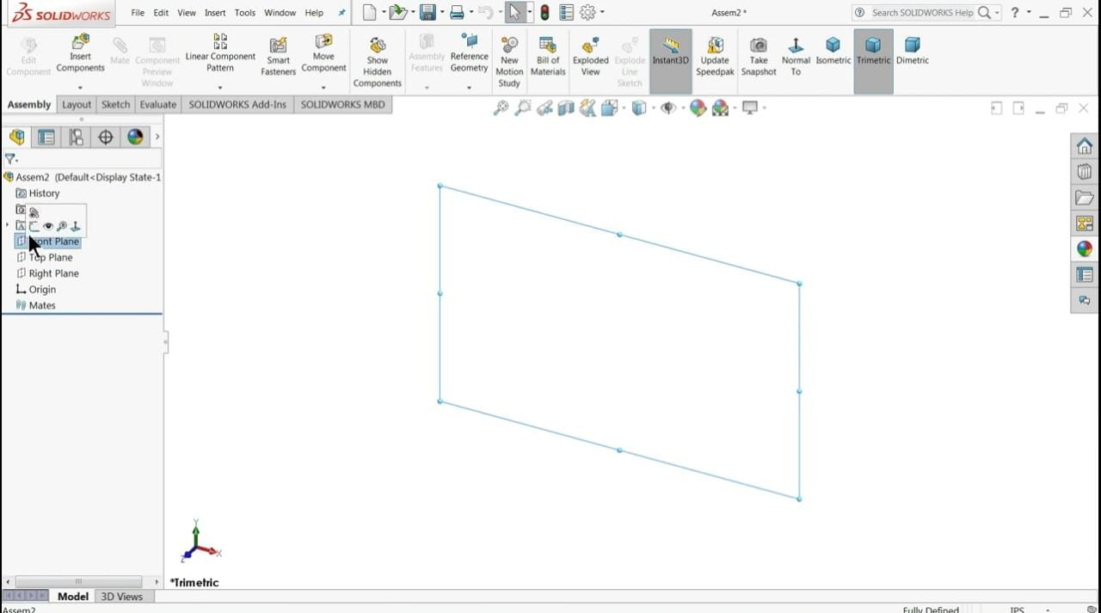
School of Computing Science & Engineering
Course Code : BME01T1004 Course Name: Engineering Graphics

Slide 5
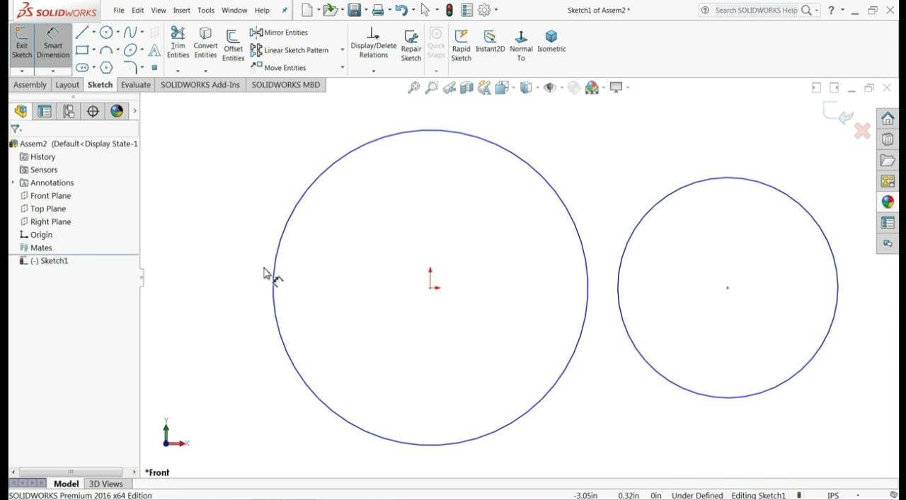
School of Computing Science & Engineering
Course Code : BME01T1004 Course Name: Engineering Graphics

Slide 6
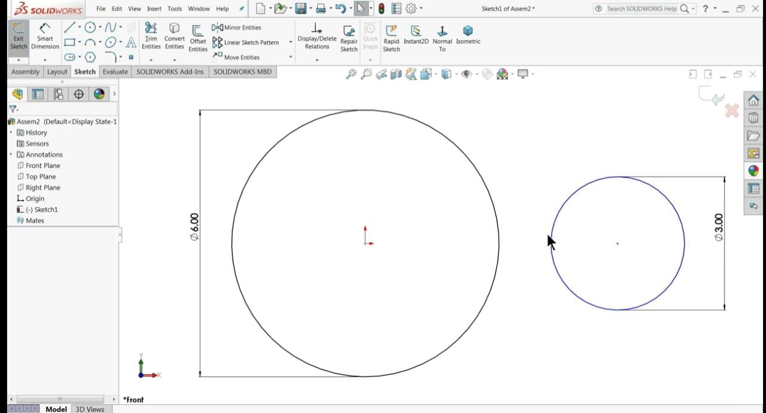
School of Computing Science & Engineering
Course Code : BME01T1004 Course Name: Engineering Graphics

Slide 7
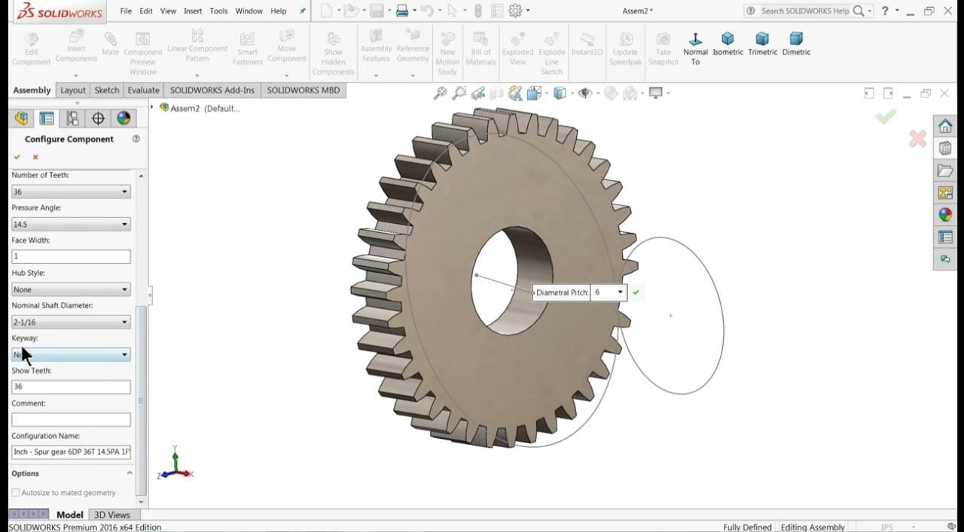
School of Computing Science & Engineering
Course Code : BME01T1004 Course Name: Engineering Graphics

Slide 8
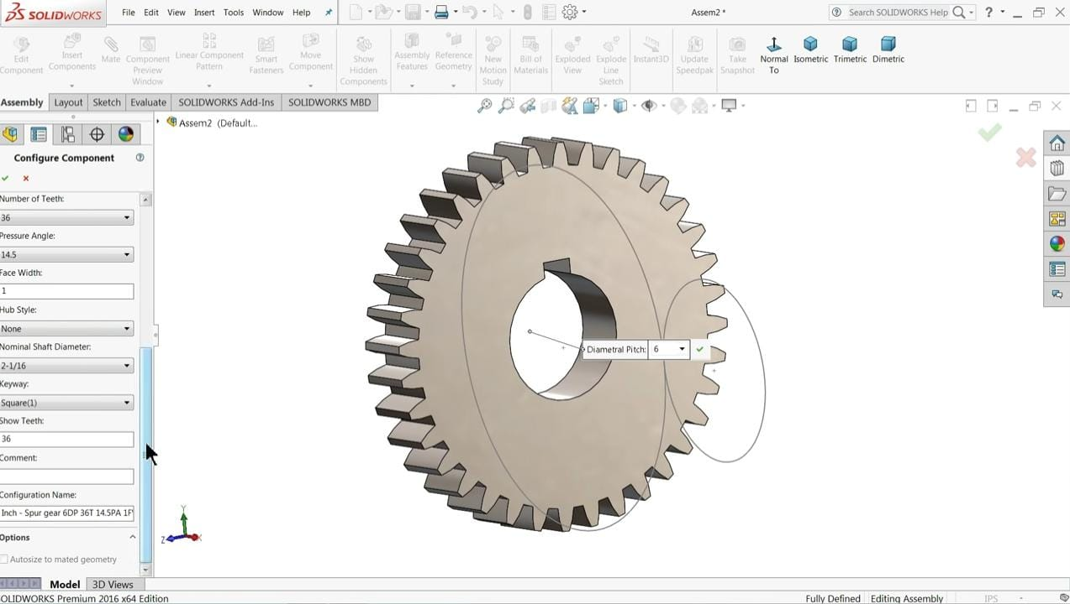
School of Computing Science & Engineering
Course Code : BME01T1004 Course Name: Engineering Graphics

Slide 9
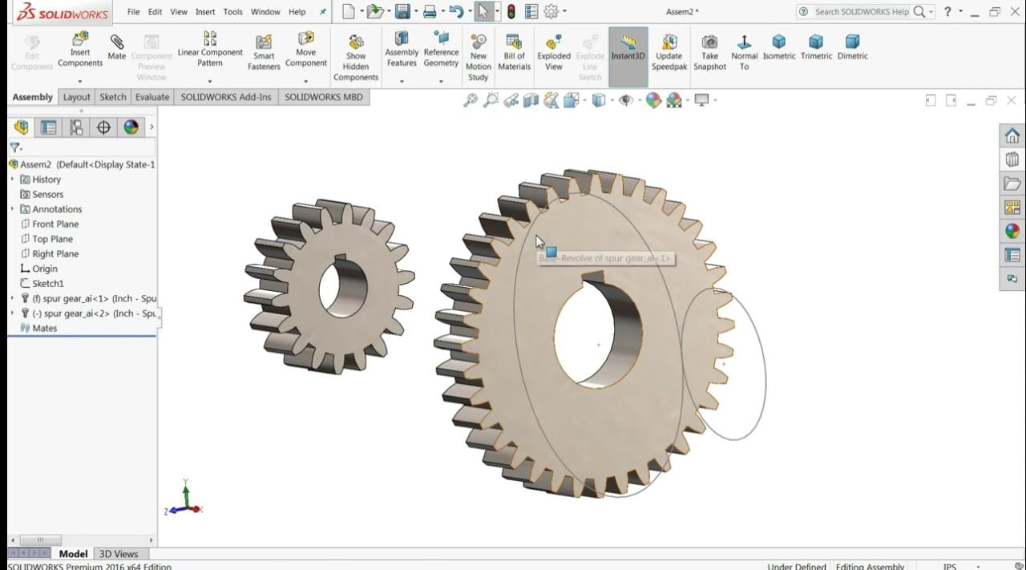
School of Computing Science & Engineering
Course Code : BME01T1004 Course Name: Engineering Graphics

Slide 10
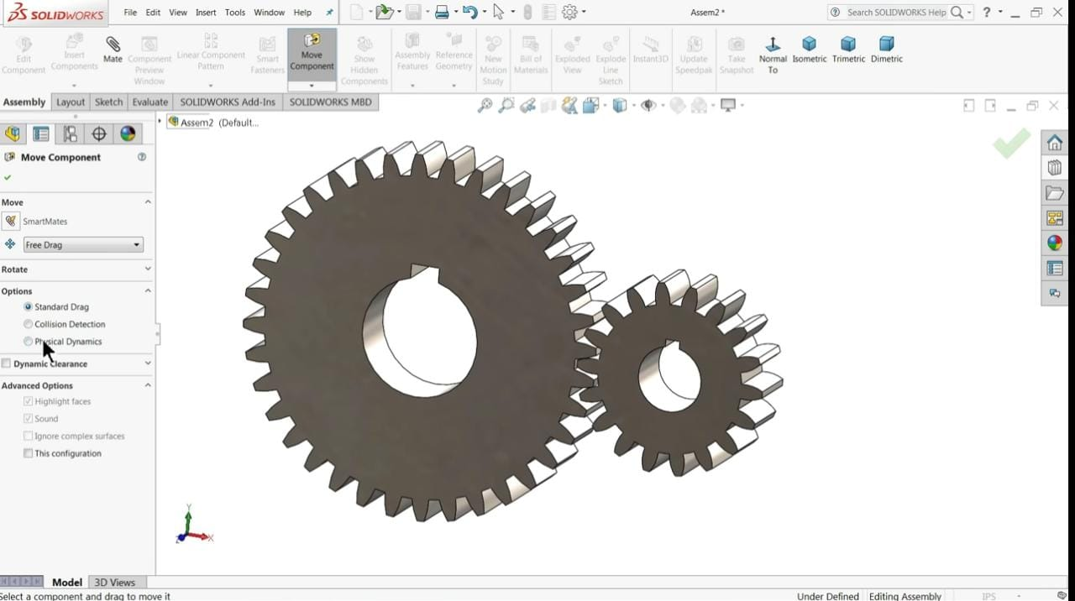
School of Computing Science & Engineering
Course Code : BME01T1004 Course Name: Engineering Graphics

Slide 11
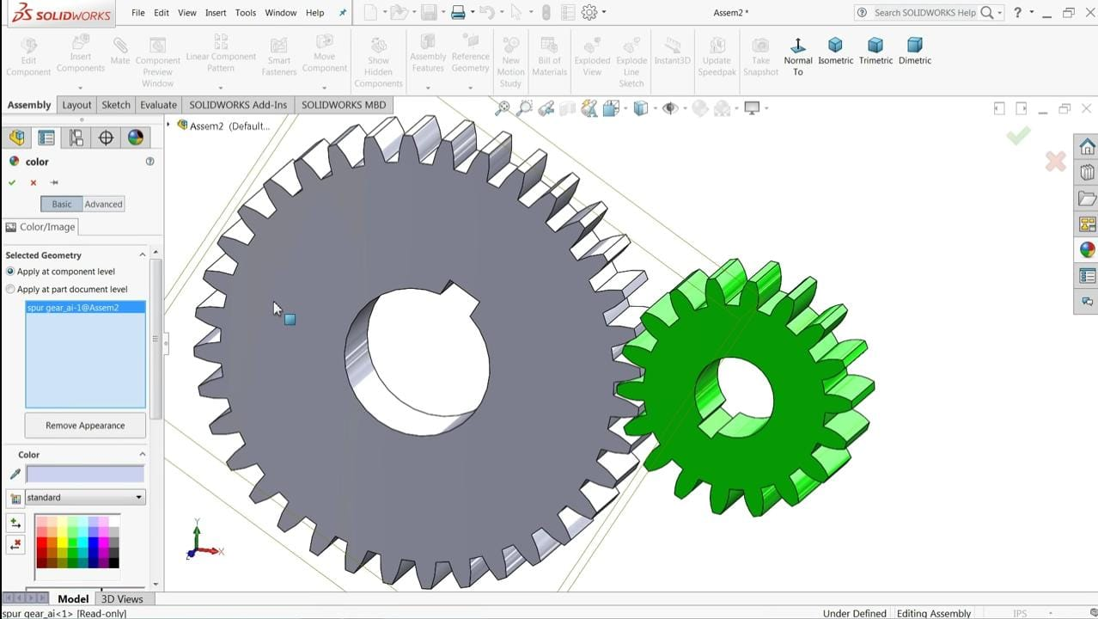
School of Computing Science & Engineering
Course Code : BME01T1004 Course Name: Engineering Graphics

Slide 12

School of Computing Science & Engineering
Course Code : BCS01T1004 Course Name: Engineering Graphics

